Slide 1
Task 4: Hydrology Mapping

Slide 2
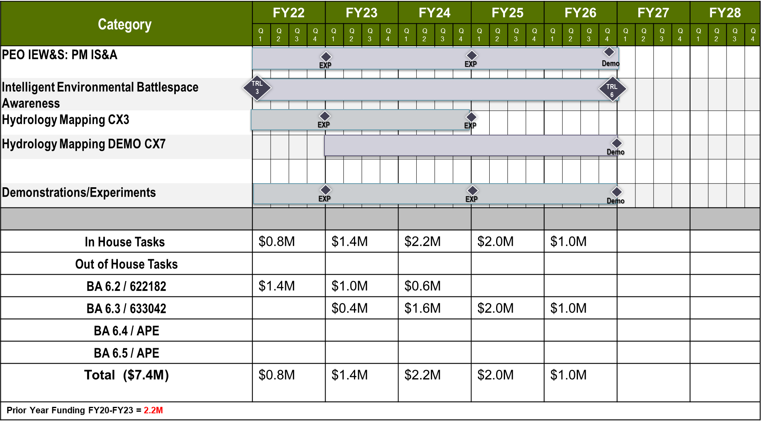
Capability Set 27 Design Goal 5
Intelligent Environmental Battlefield Awareness: Task 6.2: Hydrology Mapping (FY22-24)
Task 6.3 Hydrology Mapping Demonstration(FY23-26)
METRICS DATA
SUMMARY
Goal (what are you trying to do?/Problem trying to solve?):
Provide Army mission planners with predictions of soil moisture state, infiltration, and runoff that better reflect the high degree of spatial and temporal variability in ground and surface water threats to ensure movement through restrictive terrain.
If successful, what difference will it make?
More accurate and timely prediction of flood events
Enable better decision making during high tempo operations, particularly in A2/AD OCONUS sites.
Issues/Risks:
High physical heterogeneity may result in models that represent the distribution of system behavior better than they reflect the precise conditions at any given spatial/temporal point.
Performers (In-house/out-house):
In-house: AGE- Node (Collaborative) , NORTHCOM,TCM-Geospatial, MSCOE
Out-house: Limnotech
PARAMETERS | TECHNICAL METRICS | DEMONSTRATED PERFORMANCE | COMMENTS
Hydrologic—evapotranspiration-vegetation algorithm | High frequency soil moisture estimation | FY24, Q4 | MSSPIX24
Hydrologic freeze/thaw-infiltration algorithm | High latitude surface runoff prediction | FY24, Q4 | NORTHCOM
Gridded hydrologic overlays in GIS platform | Global channel flow and soil moisture | FY26, Q4 | AGE-NODE
Requirements: MDO TP525-3-1.3-5.d.2, Training and Doctrine CMD 525-3-1, TM No. 3-34.43
Mid-term/Final Measures of Success: Development of the data processing system and validation of the spatially explicit dynamic algorithms. Final success is a field demonstration tool (tool/data informing both the integrated intelligence module and joint partners) incorporating the ground and surface water prediction tool for identification of potential maneuver hazards.
Transitions: PEO IEW&S, PM-DCGS-A
Other CFT Dependencies: TBD
COST & SCHEDULE
PROGRESS
Last 6 Month Accomplishments:
Selecting subtask leads and planning for anticipated workload.
Pre-task coordination with task 2 (Arctic Threat/Arctic Threat Demonstration) to plan data exchange for FY21 field campaigns.
Next 6 Month Plans:
Compilation of software and development of IT infrastructure for high intensity hydrologic modeling
Review of vegetation succession models that can be leveraged for evapotranspiration
Improve initial condition, boundary condition, and model parameterization for grid based hydrologic code

Slide 3
PROJECT/TASK OVERVIEW
Project/Task Title
Last update (DD-MMM-YY)
SUMMARY
TECHNICAL APPROACH
Goal: What is the problem to solve? Describe without using jargon.
Impact: If Successful, what difference will it make to the Soldier, the operational impact? What increased capability will this project provide the Soldier that is not currently provided?
Issues/Risk: What are the technical and/or structural challenges that need to be resolved to solve the problem? issues/risk to the project that could delay the transition of the project
In-house Partners: Who are the other ERDC, CCDC Partners?
Out-house Partners: (Contractor, Academia, Federal, other)?
Requirement: AFC Mission Guidance, MDO concept, FCC requirement
How is it done today?
Don’t try to undersell or be too negative to make your approach seem better in comparison. Be truthful but also uncover the deficiencies
What are the limitations/gaps?
Describe the relevant physical constraints that need to be overcome in the technology development (e.g., velocity, weight, bandwidth, data.)
Addressing why the challenges are difficult to solve is a question that asks and sheds light on “Why can’t someone else just go do it?”
What’s new in your approach?
This is an ‘outside view’ question that confronts the possibility that there are lots of smart people around, none of them have done this, and there are probably good reasons why.
Old Chart….decision to not use pending
COST & SCHEDULE
PROGRESS
Cost & Schedule Quad (Editable slide in backup)
Follow the template, do not use any or create another version
Timeline should be through life of project. Provide total Funding (FY??-FY??) at the bottom of the chart.
Program/Project/Task Name: Program (If any), Programmatic Structure in order based on level of work.
Breakdown funding as shown in table.
What was accomplished in the last 6 months?
Developed preliminary requirements and use case analysis
Completed Soldier User Jury to validate operational and technical concepts . Report to be published 2/2019
Contract Awarded For Mission Execution Capability (Jan 2019)
What are the projected accomplishments in the next 6 months?
Contract Award For Robotic Planning Capability (Feb 2019)
Complete 2nd Iterative User Jury to obtain feedback on the software system
Demonstrate TRL 5 capability in Mission Command System
Engineering Evaluation with
Notes:
PROJECT OVERVIEW:
A stage gate review is an execution review, focused on the current year. This chart is an overview of the Project intended as a quick summary and to provide context for the following stage gate charts.
Include the last chart update in the top left corner (DD-MMM-YY).
Calibri (Body) Font, minimum 10. Quadrant titles Arial 14.
Summary Quad:
Project Goal: What are you trying to do?
Project Impact: What increased capability will this project provide the Soldier that is not currently provided?
Project Risks: issues/risk to the project that could delay the transition of the project
In-House Partners: What organizations are providing support to the overall project development?
Out-House Partners: What organization (Industry, Academia) are providing support to the overall project development?
TECHNICAL APPROACH Quad:
How is it done today?
Don’t try to undersell or be too negative to make your approach seem better in comparison. Be truthful but also uncover the deficiencies.
What are the limitations/gaps?
Identify and describe the relevant physical constraints that need to be overcome in the technology development (e.g., velocity, weight, bandwidth, data. etc.) –
Addressing why the challenges are difficult to solve is a question that asks and sheds light on “Why can’t someone else just go do it?”
What’s new in your approach?
This is an ‘outside view’ question that confronts the possibility that there are lots of smart people around, none of them have done this, and there are probably good reasons why.
You should know the reasons before you start, and explanations like "they weren't smart enough" or "they simply never thought about this topic" are probably incorrect.
One answer may be that technology has advanced to the point where a new material or signal processing algorithm now enables the feasibility of an approach that was previously unsuccessful.
COST AND SCHEDULE quad:
Do not deviate from the task titles associated with the Program Element and Project Number. If you have questions speak to your Technical Director’s office or MIOs.
Task titles must map to Task titles in L2 Roadmap
Enter only ending TRLs
Enter dollar ($) values as shown ($M, XX.X)
Need to ensure we are documenting leveraged resources such as reimbursable work, cooperative work with sister services, DARPA, etc. Out year may only be an estimate. Keep current year accurate.
PROGRESS Quad:
Include Soldier juries as often as possible.
Which Knowledge Point (KP) or Experiment or Decision Point (DP) was accomplished (see slide 3) ? What is projected in the next six months?

Slide 4
Overview of Team and Research Area
Task Manager: Chuck Downer (CHL)
4.1 Data Integration
Gutenson/Wahl (CHL)
Scott Christensen (ITL)
4.2 Vegetation Succession Models
Todd Streissberg
4.3 Spatially distributed soil moisture and run-off
Nawa Pradhan
Chase Hamilton (CHL)
John Eylander (CHL)
Decades of experience in each sub-task
FORGE THE FUTURE
Notes:
Slide 13- Army recommendations here?
Response: Similar to Heilmeier question - If successful in solving the problem, what difference will it make and why? Who cares? The operational gap the Project is addressing, quantify the metric planned to achieve.
Include freeform slides to show task leads and team structure, discuss the technology, who’s doing what outside of ERDC (assessment of research across the S&T community – other services, DARPA etc)? How much resources are they investing and how do you plan on leveraging?

Slide 5
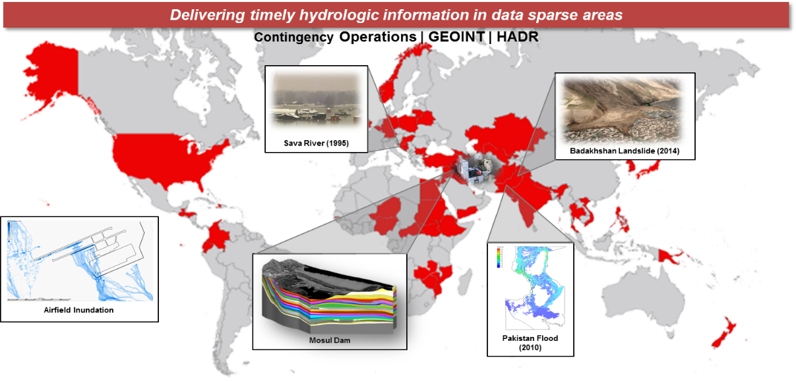
Current State of the Art: Hydrologic Support Occurs via Reachback
DoD Joint Capability Areas require hydrologic information in order to effectively accomplish their mission. E.g. battlespace awareness; risk mitigation; logistical support; and partnership building
Army concerns within the hydrologic domain are currently addressed via ad hoc requests through the USACE Reachback Operations Center (UROC). This approach relies heavily on subject matter expertise and does not scale for potential large-scale conflicts with a near-peer adversary.
There is no authoritative DoD enterprise solution to assess hydrologic impacts on military operations.
FORGE THE FUTURE
Notes:
Similar to Heilmeier question – How is it done today, and what are the limits of current practice?
DoD Joint Capability Areas (e.g. battlespace awareness, risk mitigation, logistical support, and partnership building) require hydrologic information in order to effectively accomplish their mission.
This includes: wet gap crossings; augmented reality; autonomous maneuver; IED detection; flood risk and exposure; climate extremes; contaminant fate and transport; navigability of waterways; off-grid power generation; bridging; fording; base site identification; climate security; water security; food security; drought mitigation; water diplomacy, etc.
There is no authoritative DoD enterprise solution to assess hydrologic impacts on military operations.
As a result, Army needs within the hydrologic domain are currently addressed via ad hoc requests for information through the USACE Reachback Operations Center (UROC).
The current status quo relies heavily on subject matter expertise and involves lengthy response times. This approach does not scale appropriately to meet the demands of potential large scale conflicts.
Future autonomous and semi-autonomous systems will require extensive environmental information to operate effectively on the battlefield. Dynamically changing weather impacts are difficult to assess in data sparse areas, particularly in a disconnected environment such as a battlefield
An operational global hydro-terrestrial modeling framework is needed to better support the DoD Joint Capability Areas with continuous modeling and simulation results available anywhere in the world on demand.
REQUIREMENT: "Army and DOD policy documents place specific responsibility on the USACE as the director and monitor for Army programs in the atmospheric, topographic, hydrographic and terrestrial sciences. This includes providing simulation and visualization of environmental effects on Army assets; supporting and conducting relevant RDT&E activities to provide hydrological studies, forecasts, decision aids, and exploitation tools for military training, operations, and emergency response; and operationalizing and transitioning appropriate technologies to the USAF in support of Army operations. Outside the United States, USACE provides support through modest reimbursable efforts or engineering reachback activities. Alignment of organization strengths and core competencies is needed to field best-in-class tools that provide authoritative information for advanced decision making in support of DOD and USG requirements globally."

Slide 6
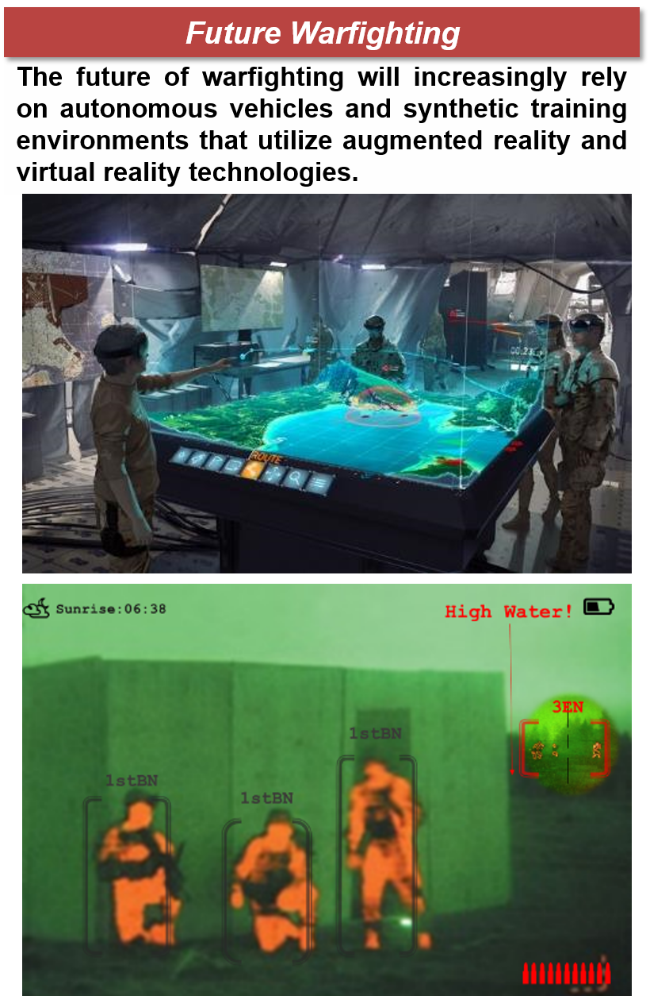
Global Hydrologic Awareness with Local Precision
Reconstruct historical streamflow and soil moisture states in a manner that is spatially continuous using state-of-the-art climate reanalysis datasets.
Characterize seasonal variation, severity and likelihood of impactful events as this relates to estimates of flow velocity, depth, top width, and relative soil moisture and soil strength.
Develop a data model that expresses time-dependent variables with reduced order models (e.g. polynomial expressions) for operating in disconnected environment.
Targeting deployment on the Next Generation Geospatial Work Station and other data services and web applications
Key Takeaway
FORGE THE FUTURE
Notes:
Slide 13- Army recommendations here?
Similar to Heilmeier question - What is new in your approach and why do you think it will be successful? Who cares? If you are successful, what difference will it make? What are the risks?
How much will it cost? How long will it take?
Freeform vs guided chart – Kim will address during discussions.

Slide 7
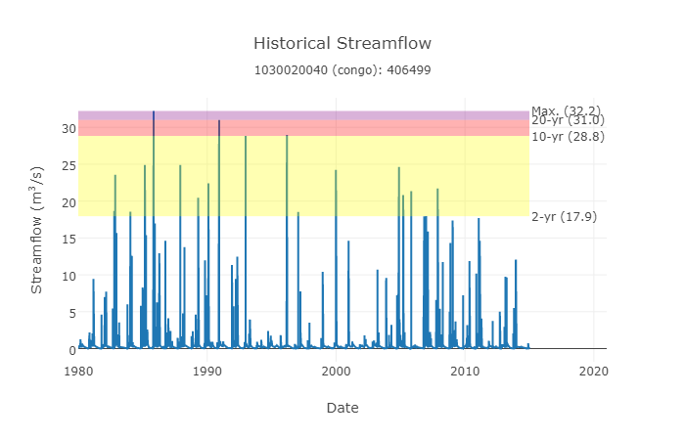

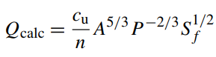
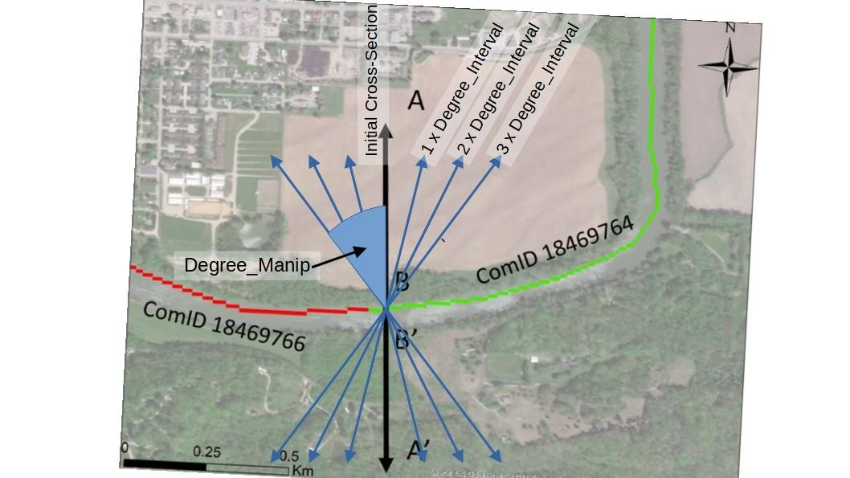

FY22 Overview
Streamflow Distribution
Fraction of Peak Discharge | Q (cms)
1/15 | 2.15
2/15 | 4.29
3/15 | 6.44
…
15/15 | 32.2
Database Containing Discharge (Q), Velocity (V), Top Width (T), and Water Surface Elevation (WSE) that can be used to characterize seasonal variation.
Run Hydraulic Simulations with Streamflow Distribution
Building an authoritative base layer of hydrologic and hydraulic seasonality
FORGE THE FUTURE
Notes:
Slide 13- Army recommendations here?
Similar to Heilmeier question - What is new in your approach and why do you think it will be successful? Who cares? If you are successful, what difference will it make? What are the risks?
How much will it cost? How long will it take?
Freeform vs guided chart – Kim will address during discussions.

Slide 8
List of Collaborators/ Leveraged Projects across ERDC
Leveraged Projects | Direct or Reimbursable/Lead Lab | Communication Strategy
Microhydro | Direct Add /CERL | TBD
Hydro-modeling enhancements | Reimbursable/CHL | Monthly meetings with sponsor to ensure collaboration without overlap of efforts
DRI Add?
Flood Mapping of Mill Creek, TN | Reimbursable/CHL | Monthly meetings with sponsor to provide updates on the projects progression.
USACE MVD Future Floods | Direct/CHL | Bi-weekly team meetings to track project progression.
Explicitly state who else is funding this research…ex.: ME for ECW or Airforce for Soil Task
List all relevant effort leveraging and communication being done across ERDC with other direct and reimbursable efforts
Key Takeaway
FORGE THE FUTURE
Notes:
Slide 13- Army recommendations here?
Response: Similar to Heilmeier question - If successful in solving the problem, what difference will it make and why? Who cares? The operational gap the Project is addressing, quantify the metric planned to achieve.
Freeform vs guided chart – Kim will address during discussions.

Slide 9
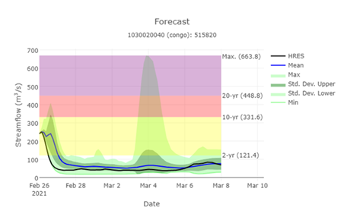
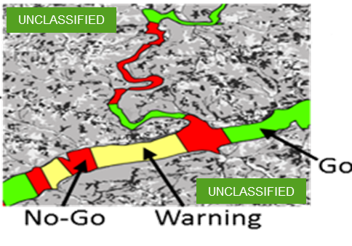
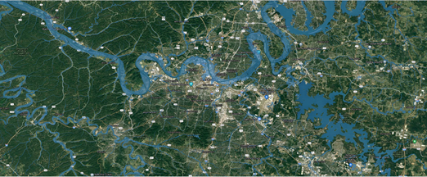
Expected Outcomes, Impact & Payoff
The current patchwork of hydrologic and hydraulic support results in non-authoritative and sometimes conflicting analyses originating on non-accredited networks that are too often available only after the fact.
Decision makers on secure and accredited networks need timely, authoritative, information on hydrology and hydraulics at nearly any location around the globe.
The developed computing infrastructure will centralize, aggregate, automate, and report data to global hydrologic and terrain states that can feed into downstream applications (e.g., wet gap crossing analysis).
From Streamflow to Decision Support
FORGE THE FUTURE
Notes:
Slide 13- Army recommendations here?
Response: Similar to Heilmeier question - If successful in solving the problem, what difference will it make and why? Who cares? The operational gap the Project is addressing, quantify the metric planned to achieve.
Freeform vs guided chart – Kim will address during discussions.

Slide 10
Results to Date
Freeform-What results do you have to date?
How has science been advanced?

Slide 11
CURRENT STAGE GATES
Task Title
Last update (DD-MMM-YY)
Task Level Brief Only
Should be 1 slide only. Focus on current year and following year.
Project Level Brief: Stage Gate in Backups.
Category | Description | Planned Completion Date | Actual Completion Date | Status/Results | Recipient
Knowledge Point 1 | Establish …. achieve XX% increase to metric XYZ current threshold in the laboratory environment. … | 08/2020 | 08/2019 | Complete | Internal
Knowledge Point 2 |  |  |  | Delayed / On Schedule / Complete | Internal
Knowledge Point 3 |  |  |  | Delayed / On Schedule / Complete | Internal
Experiment / Demonstration 1 | Determine breadboard technology increased sufficiently to reasonably achieve metric objective. |  |  | Delayed / On Schedule / Complete | Internal
Decision Point 1 | Go / No Go Decision. Rationale is …. achieving TRL 5 (Decision Point ex: Demo 1 met/did not meet Threshold Obj) |  |  | Delayed / On Schedule / Complete | PEO / Stakeholders
Knowledge Point 4 |  |  |  | Delayed / On Schedule / Complete | Internal
Knowledge Point 5 |  |  |  | Delayed / On Schedule / Complete | Internal
Experiment / Demonstration 2 |  |  |  | Delayed / On Schedule / Complete | PEO, Stakeholders
Decision Point 2 | Go / No Go Decision. Rationale is …. achieving TRL 6 |  |  | Delayed / On Schedule / Complete | PEO, Stakeholders
Each DP is preceded by KPs and experiments/demonstrations. Each DP is a Go/No-go decision point (a “Gate” to be passed for leadership/stakeholders make a decision to determine whether the project moves to the next "Stage"). Each DP includes transition partners and stakeholders.
Notes:
Ensure all S&T Project TRL Demonstrations are captured over the life of the project in chronological order. While the emphasis of this slide is on current and following year, prior FY completions should be reflected if they were completed after the September Stage Gate submission. Provide complete stage gate table for the entire life of the project in backups.
Any key milestone on the program’s critical path that produces an output that a decision maker uses to determine if the program can move to the next phase or if adjustments are required. Examples, at a minimum, include major system engineering milestones (i.e., PDR and CDR), any change in TRL, all planned demonstrations (whether or not they result in a TRL change), and critical knowledge points (example would be if M&S was required to show technical feasibility to reduce technical risk) (proposed)
In stage-gate processes decisions are made based on the knowledge and information developed during the preceding phase.
Decision Point: Project Go/No Go Leadership decision points. Decision Points are “Gates” the decision points for whether or not to proceed to the next stage.
Examples of Stage gates:
Transition Agreement Status (Gate)
Key Decision Points (Gate)
Key Knowledge Points (Stage)
Insertion Points (Stage)
Key Experiments (Stage)
Changes/Approved TRL updates (Gate)
All Demonstrations (Senior Leader should be aware of) (Stage)

Slide 12
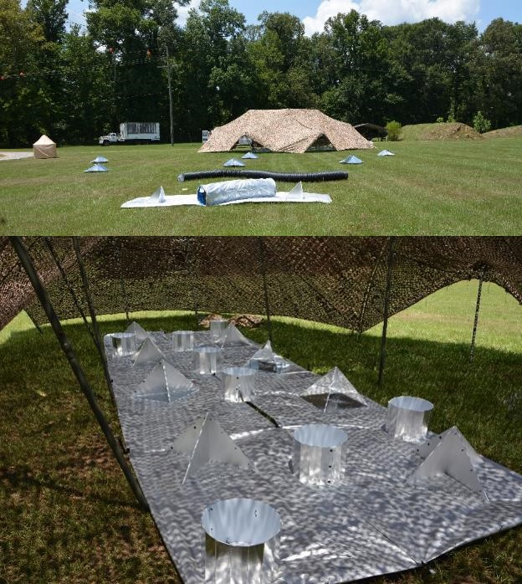
GOOD NEWS
Project Title
Last update (DD-MMM-YY)
Challenge: Monitoring and predicting soil state conditions for maneuver support, mobility assessment, and other modeling efforts such as determining vehicle underbody blast loading. Innovation: Enable weather-impacted soil moisture and soil strength information at tactical-scale resolution (less than 100m) using physics-based downscaling modeling capabilities. Data inputs are flexible and can come from authoritative data sources (557th Weather Wing (557WW), National Geospatial-Intelligence Agency, etc), or the user can bring their own data and algorithms. Benefits: Global availability of weather-impacted soil moisture and soil strength for mobility analysis. Python architecture enables plug-and-play integration of alternative input data and algorithms and performs on-the-fly data access and processing. User-defined products (UDPs) enable users to bring their own parameters, algorithms, data, perform temporal analysis, and customize soil strength analysis. Accomplishments: Integration of GeoWATCH onto 557WW test servers and ensuing evaluation. First installation of GeoWATCH on 557WW Development server and ensuing evaluation. Developed ArcGIS Toolbox containing GeoWATCH soil moisture downscaling algorithms and the Army’s Standard Mobility (STNDMOB) for integration into DCGS-A. Results and Transition: Use of GeoWATCH products to help determine the amount of air filled voids in a particular soil which is used to calculate the impulse that would be imparted by a buried charge in that soil. Experiment conducted at Fort Polk. Second installation of GeoWATCH on 557WW Development server underway.
Hidden for FY22 New Start
Notes:
First year project may not have an accomplishment to highlight. Recent demonstrations, transfers, etc. that relate and demonstrate your ability to deliver are important to highlight.

Slide 13
Accomplishment Status
Planned | Status
Task One: Environmental Data Collection, Analysis, and Storage GIS based desktop terrain-analysis and Sample planning tool Expanding EBS Form Builder for multiple forms Complete MICA integration with sensor devices Complete sensor integration with ENFIRE Radiological Sensor Development | Ongoing Ongoing Ongoing Ongoing Ongoing
Task Two: Detection of Biological Contaminants in Air and Water Binding and Identification of the E. coli broad and human specific with AQUA PATH II Integration of the JUNO and WaterDOG into Task One Software | Ongoing Completed
Task Three: Detection of Chemical Contaminants in Soil and Water Expand capabilities of the PET kit Develop test strips Develop cell phone based spectrometer Optimized iron-oxide- and resin-based geochemical sensors (XRF Detection) | Completed Ongoing Ongoing Ongoing
Hidden for FY22 New Start
Key Takeaway
9
Notes:
Chart to be used to lay out planned and actual accomplishments.
Replace XX with FY digits for Planned and Actual tables
The Accomplishment tables continue two columns; the gridlines are hidden
Click after 1Q to enter data; data will word wrap within the cell, if needed
Press [Enter] if second accomplishment to be entered for a Q
Tab to 2Q, tab to cell to enter 2Q data, etc.
Use mouse to navigate to second table, “Actual Accomplishments”
Object will not AutoFit; font must be decreased if text overspills slide

